Slide 1
Covid-19 Dataset
Name : S . Indhumathi
Batch : Oct-2025
Course: Data Analytics

Slide 2
Overview of Covid-19 Dataset
The COVID-19 dataset is analyzed in Power BI to understand global pandemic trends.
It includes data on confirmed cases, deaths, recoveries, and active cases across countries and regions.
Power BI visuals are used to compare country-wise and WHO region-wise impact.
The dataset helps transform raw data into interactive and meaningful insights.

Slide 3
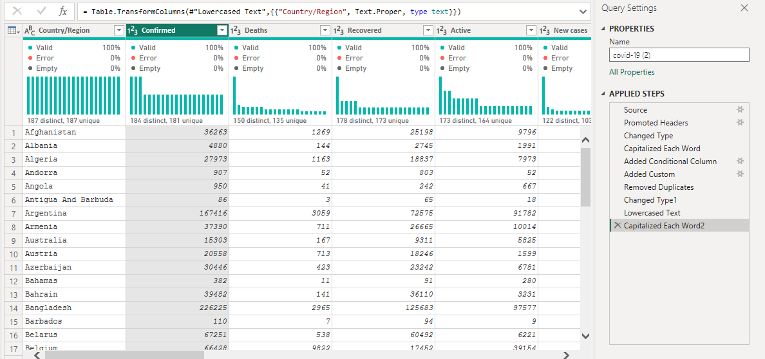
Data Preparation & Cleaning
Calculated Recovery Percentage
"Recovery Percentage", = ([Recovered]/[Confirmed])*100)
Calculated Conditional Column Using
"Case Status", Each If [Deaths] >= 100000 Then "High Risk" Else If [Deaths] >= 50000 Then "Medium Risk" Else "Low Risk")
Removed Duplicate Or Invalid Records
Prepared Data For Accurate Analysis

Slide 4
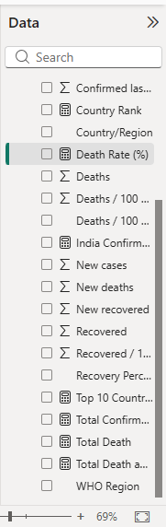
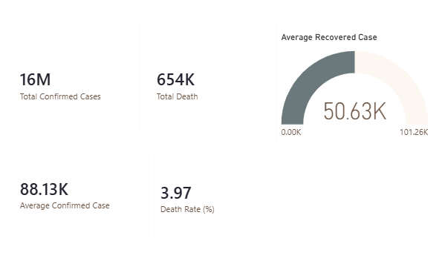
DAX Measures
Measures were created to calculate Total Confirmed Cases, Total Deaths, and Total Recovered Cases.
Additional measures such as Recovery Rate and Death Rate help evaluate COVID-19 impact.

Slide 5
Dax Measures Formula
TOP 10 Countries
Top 10 Countries = TopN(10,values('covid-19'[country/Region]), [Total Confirmed Cases],desc)
Total Death And Recovered Cases
Total Death And Recovered Case = Sum('covid-19'[deaths])+sum('covid-19'[recovered])
Death Rate Percentage
Death Rate % = Divide([total Death],[total Confirmed Cases],0)*100
India Confirmed
India Confirmed Case = Calculate([Total Confirmed Cases],’Covid-19’[Confirmed]=“India”)

Slide 6
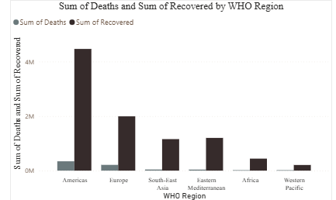
WHO Region-wise COVID-19 Impact
The chart shows COVID-19 deaths and recoveries across different World Health Organization regions.
The Americas and Europe experienced the highest impact, while Africa and the Western Pacific reported lower case volumes.
Higher recovery numbers in most regions indicate improved healthcare response.

Slide 7
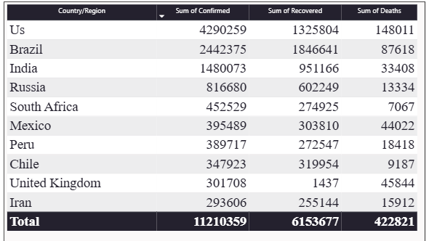
Country/Region-wise COVID-19 Case

Slide 8
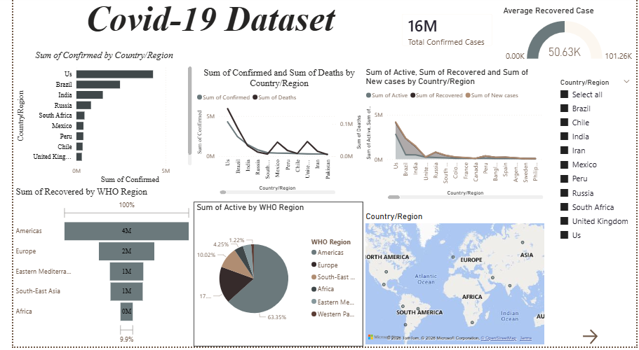
Dashboard Overview

Slide 9
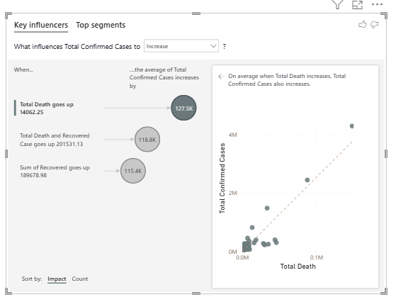
Key Influences

Slide 10
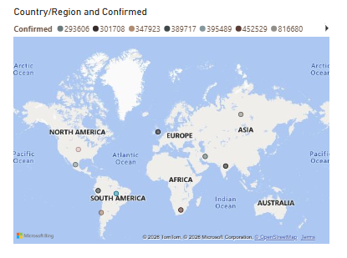
Map Analysis
Regions Such As North America, Europe, And Asia Show Higher Case Concentrations Compared To Other Continents.
Supports Geographical Trend Analysis

Slide 11
Key insights
COVID-19 cases showed a rapid increase during peak periods, followed by gradual stabilization over time.
North America, Europe, and Asia emerged as the most affected regions based on confirmed case counts.
Recovery rates improved steadily, indicating better healthcare response and treatment effectiveness.
Geographical and time-based analysis helped identify hotspot regions and critical periods for intervention.

Slide 12
Conclusion & Recommendations
This Power BI project effectively analyzes global COVID-19 data using interactive dashboards and visualizations.
The analysis highlights key trends in confirmed cases, deaths, and recoveries across countries and WHO regions.
DAX measures and Power BI visuals helped transform raw data into meaningful insights.
Overall, the project demonstrates how data analytics supports better understanding and decision-making in public health.

Slide 13
Thank you

